Slide 1
Test Log Analyzer
Khizar Saud
August 2022
Notes:
bh

Slide 2
Topics
1
Problem Statement
2
Primary Goal
3
Design Approach
4
Demo

Slide 3



Problem Statement
1
During a regression run PREG team spends a lot of valuable time manually analyzing log files to figure out which test case failed, where the error occurred , and the type of error. We want to minimize the amount of time spent and the possibility of human error.

Slide 4
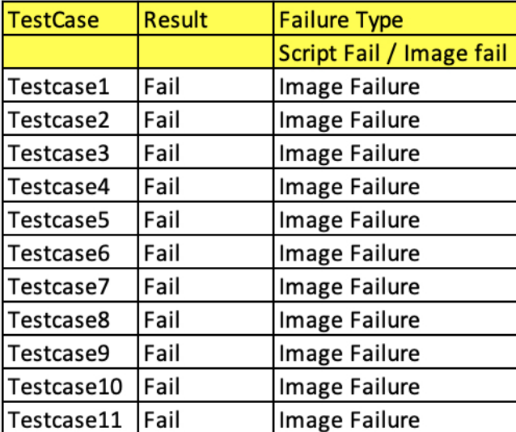
Primary goal
2
Create a quick, simple, easy to use UI which will save engineers time by analyzing the log file automatically and give you a tabular view of the results.

Slide 5

Design approach
1
Main Page
3
2
Dashboard/Buttons
3
Backend Operations
4
Features In Development

Slide 6
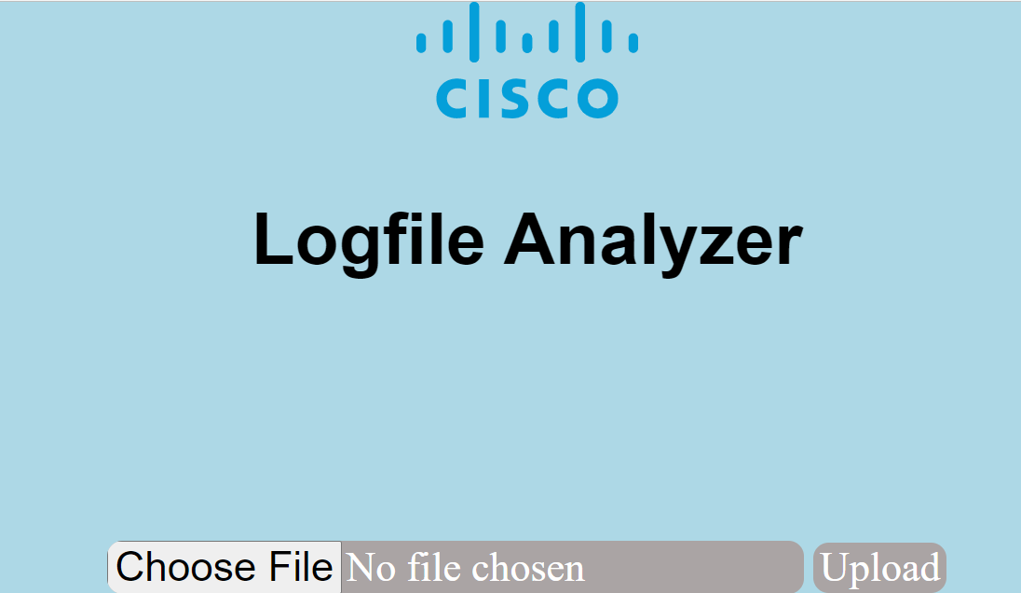
1
Main Page
Created a simple UI which takes a zip file as input
Once upload is clicked the the analysis commences

Slide 7
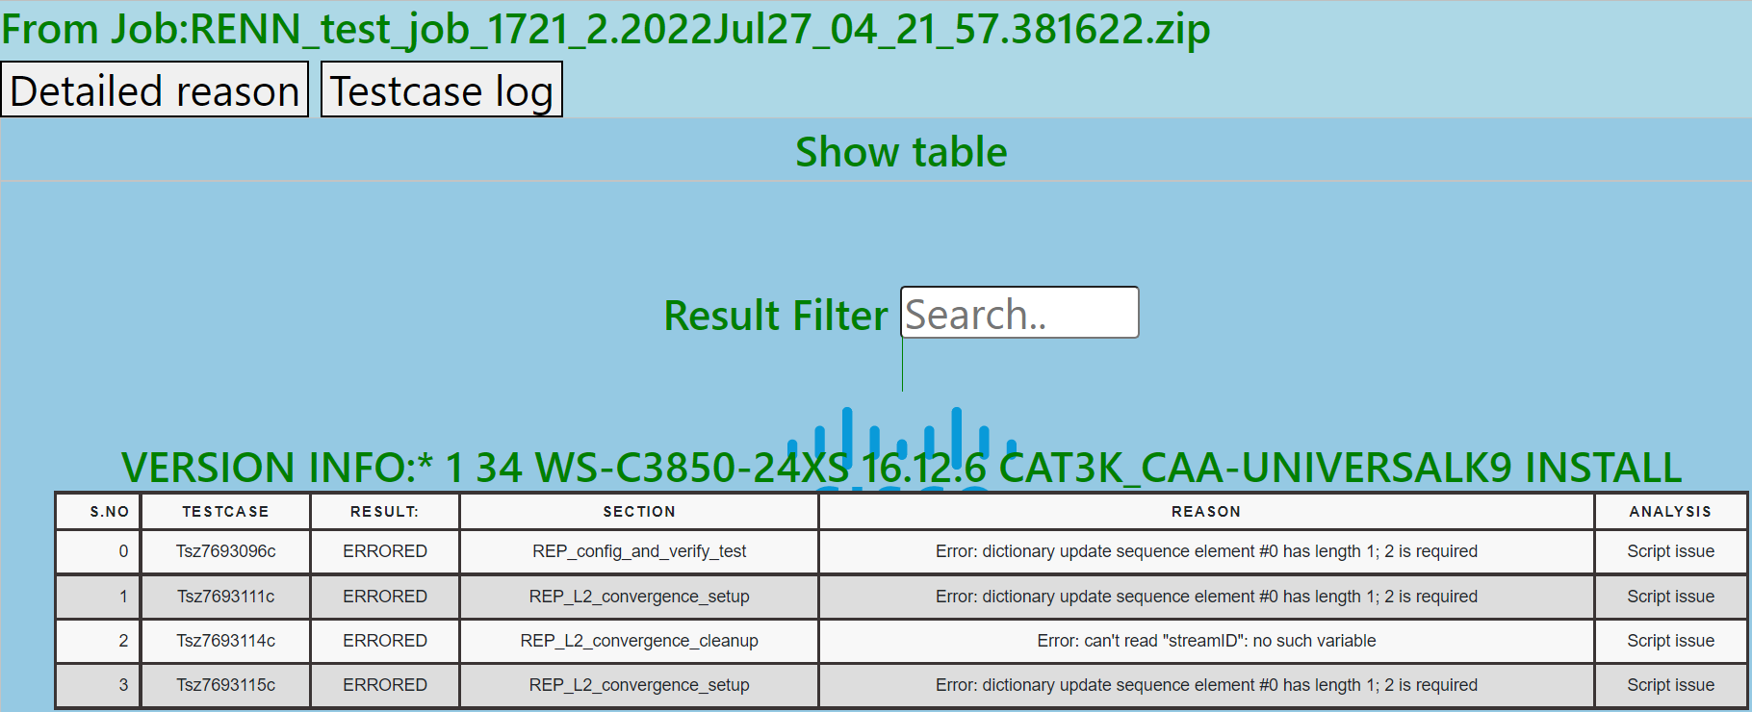
Dashboard
Overview
2
Dashboard
Once upload is clicked we are taken to the result page which displays various types of information pertinent to the job file which was uploaded

Slide 8

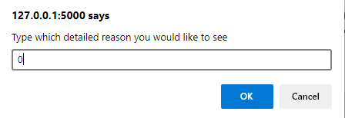
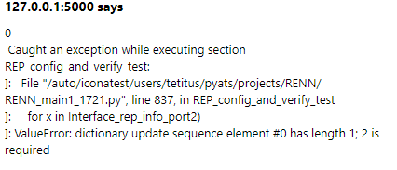
2
Dashboard- Detailed Reason button
When clicked this button asks for user input in a form of a number which correlates to each test case.
Displays a detailed error message

Slide 9

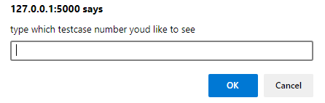
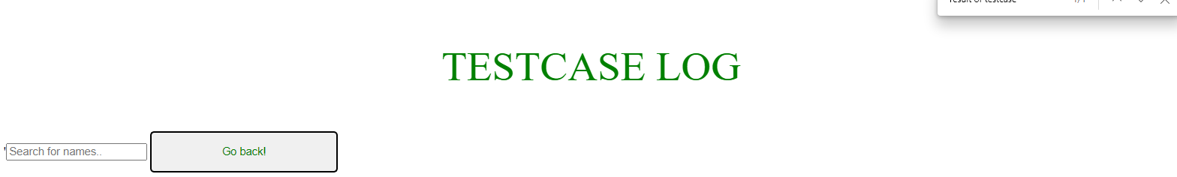
2
Dashboard- Test case log Button
When clicked this button asks for user input in a form of a number which correlates to each test case.
Displays logs of each test case
If user needs to go back to the table a button has been created to bring back the table view
Search functionality to find all occurrences of keywords

Slide 10


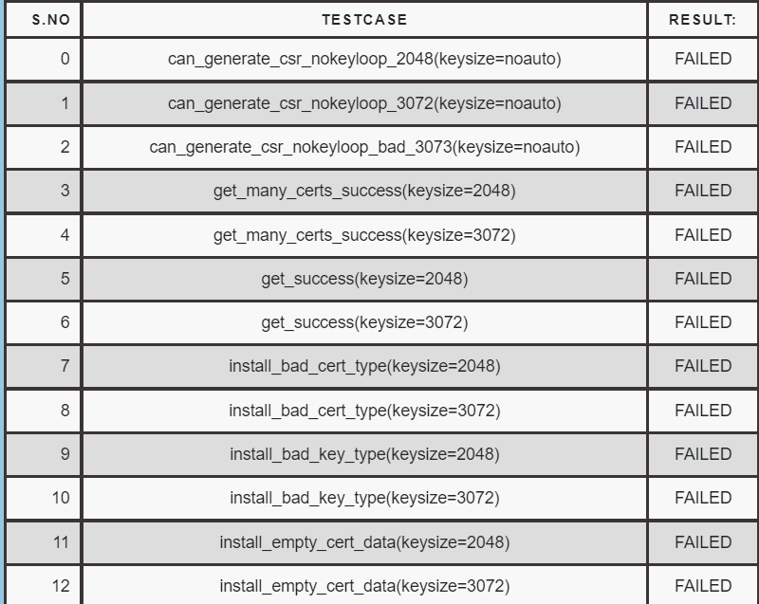
2
Dashboard-Result Filter Button
This is a useful tool inside the UI which can filter the table as the user desires
EX: If user desires to see only failed test cases, the table will change to display only failed test cases
EX: If user desires to see only script issues that occurred in the table

Slide 11

3
Backend Operations
Python for backend analysis
Flask how the application runs
CSS/JS/HTML - Design

Slide 12

4
Features In Development
Database integration where collected result is sent to database in JSON format for storage if user desires
Integrate to Cisco servers
Ability to enter text as input for file location
Fine tune results

Slide 13
Demonstration

